Slide 1
CU Feedback
CSCI 5828: Foundations of Software Engineering
Team Colorado Buffaloes
Jay Luther
Nischal Paramashivaiah
Pradyoth Srinivasan
Shruthi Sridharan
Veena Prasad

Slide 2
Project Overview - about
We have developed a platform to help Teaching Assistants at CU Boulder with a pipeline to obtain feedback from their students.
Using our application, a TA can log into their educator dashboard and send a brief anonymous survey to their students.
These surveys will contain questions to gauge understanding of core materials in class and get constructive feedback from students.
Quantitative analysis is picturized on the educator dashboard along with sentiment analysis using Natural Language Processing.
Regular feedback to educators has been shown to help increase their effectiveness, thus improving the quality of our department's undergraduate education.

Slide 3
Project Overview - about
Communication:
We used a combination of Pivotal Tracker, Whatsapp, and Zoom.
Pivotal Tracker: We used Pivotal to stay up to date on the current progress of all team members.
Whatsapp: This allows us to ask questions on the fly, whenever we run into issues or would like a quick word with our teammates.
Zoom: We hold our weekly meetings to plan the current sprint and ensure that everything is running smoothly.

Slide 4
Project Overview - about
Work Distribution:
During our weekly Zoom meeting, we spend time on Pivotal Tracker assigning stories to individuals. This allows our schedules to be a bit flexible, while also encouraging us to take different roles in different sprints.
Data Analysis: | Pradyoth Srinivasan and Nischal Paramashivaiah
Data Persistence and Data Collection: | Jay Luther
Web Application and Visualization: | Shruthi Sridharan and Veena Prasad

Slide 5
Technologies used
Project planning | Pivotal Tracker
Language | Python, Javascript, HTML
Build tool | Gradle
Testing tools | Pytest, Jest
Front-end | Javascript / HTML/ CSS
Back-end | Flask, Python
Notes:
The web application is written in Python using flask and deployed on Heroku.

Slide 6
Technologies used
Data persistence | SQLite, ElasticSearch
Messaging | Apache Kafka
Production | Heroku
Continuous Integration | Github Actions
Monitoring | Heroku
Continuous Delivery | Heroku

Slide 7
Design Decisions
Front-end : Javascript and HTML/CSS : Our application is a simple front-end web app and does not require any complex frameworks.
Back-end : Python / Flask : Python is the comfortable language for all our team members.
Database : MySQL : We are importing the data from a .csv file into Python, requiring no complex objects. As we are using Python on the back-end, MySQL is simple enough to suit our needs.
ElasticSearch : Visualization dashboard was easy to build with ElasticSearch - Kibana.
Deployment : Heroku : Having used it in Homework 4, it seemed a logical continuation to leverage our knowledge of Heroku for our application.

Slide 8
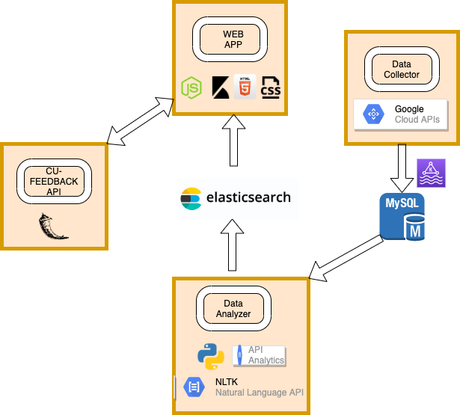
High level design (architecture)
Notes:
1 slide, 2-3 minutes
diagram of your overall application architecture

Slide 9
DEMO

Slide 10

Click Play to see the video
Notes:
4-6 minutes
Demo could be live or recorded

Slide 11
Retrospective
🙂
😐
😕
What went well?
1. Flask and SQLite Integration
2. Qualitative analysis of feedback using NLP toolkit.
3. Python working with .csv file and generating statistics.
4. UI Development
5. Team Coordination
What was confusing?
1. Google API Use with Python
2. ElasticSearch-Kibana was bit confusing to set-up for first time users.
3. Initially charting out the database schema.
4. Framing the different types of testing (unit, integration, acceptance)
5. Visualize for varied Use cases
What didn’t go well?
1. Suitable time for weekly meetings
2. Elastic Cloud Deployment. ( Account creation and maintenance)
3. Not having the In-person experience.
4. Code Coverage
Notes:
4-12 minutes
Each person should talk about 1 item

